Slide 1
www.MINEPORTAL.in
ONLINE TEST SERIES FOR
DGMS COAL/METAL FIRST/SECOND CLASS EXAM
GATE MINING EXAM
OVERMAN EXAM TEST
MINING INSPECTOR EXAMS
COAL INDIA MTs & OTHER PSUs EXAMS
FREE STUDY MATERIAL & VIDEO LECTURES
MINING JOBS NOTIFICATIONS
www.mineportal.in Call/Whatsapp-8804777500 www.fb.com/mineportal.in

Slide 2
IMPORTANT TERMINOLOGY RELATED TO
METALLIFEROUS MINING

Slide 3
SOME IMPORTANT TERMS
STOPE
CROWN PILLAR
SILL PILLAR
RIB PILLAR
SUMP
ORE PASS
RAISE
WINZE

Slide 4
STOPE
An excavation from which ore has been removed in a series of steps. Usually applied to highly inclined or vertical veins. It mainly refers to the area where we plan to extract mineral.The term is same as panel in coal mining.

Slide 5
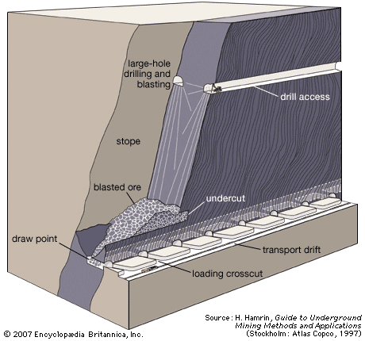
STOPE

Slide 6
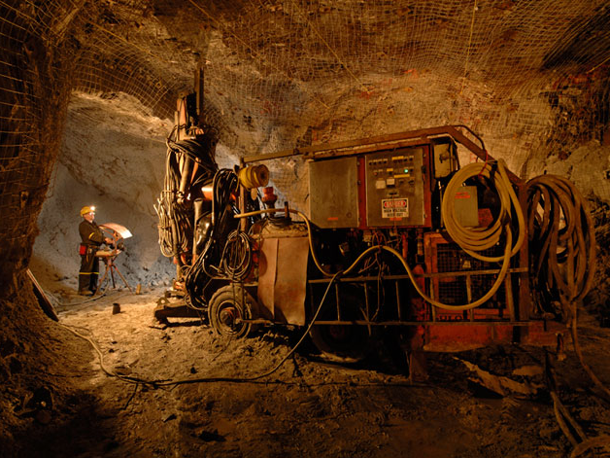
STOPE

Slide 7
CROWN PILLAR
An ore pillar at the top of an open stope left for wall support and protection from wall sloughing above.It is horizontal pillar.

Slide 8
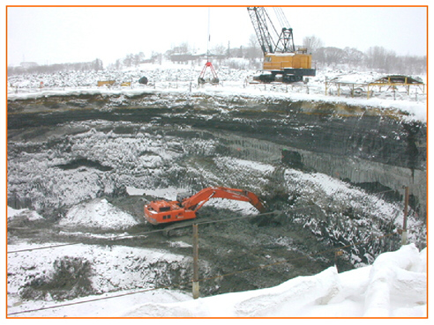
CROWN PILLAR

Slide 9
SILL PILLAR
It is also a horizontal pillar but at the bottom of the stope.

Slide 10
RIB PILLAR
These are vertical pillars on the side of stope.Generally their length is large compared with its width.

Slide 11
SUMP
An excavation made underground to collect water, from which it is pumped to the surface or to another sump nearer the surface. Sumps are placed at the bottom of a shaft, near the shaft on a level, or at some interior point.

Slide 12
ORE PASS
A vertical or inclined passage for the downward transfer of ore; equipped with gates or other appliances for controlling the flow. An orepass is driven in ore or country rock and connects a level with the hoisting shaft or with a lower level.

Slide 13
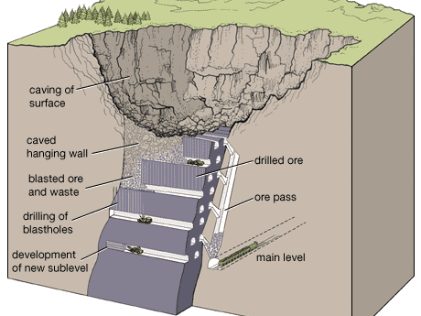
ORE PASS

Slide 14
RAISE
A vertical or inclined opening in a mine driven upward from a level to connect with the level above, or to explore the ground for a limited distance above one level. These are made from lower level to upper level.

Slide 15
WINZE
A vertical opening driven downward connecting two levels in a mine. When one is standing at the top of a completed connection the opening is referred to as a winze.

Slide 16
By :Prabhakar Gautam
B-tech: part 2
Roll no: 10108EN011
THANKS

